Slide 1
BLISS- Blended Learning Implementation for reSilient, acceSsible and efficient higher education
UNIMA – Unit 1 Six Sigma
Disclaimer: Funded by the European Union. Views and opinions expressed are however those of the author(s) only and do not necessarily reflect those of the European Union or the European Education and Culture Executive Agency (EACEA). Neither the European Union nor EACEA can be held responsible for them.

Slide 2
Agenda
Unit Overview
Constructive Alignment:
ILOs
Schedule & Activity Flow for TAs and ATs
Course Content

Slide 3
Unit Overview
Mother Course: MFE4213 Quality and Reliability Engineering (5 ECTS)
Mother Programme: Bachelor in Mechanical Engineering (Year 4)

Slide 4
Unit Overview
Study-unit Aims: This study-unit aims to give the students an appreciation of the impact of management decisions on total quality management and the achievable quality of an organization. Students will recognize the need to design in quality into a product. The study-unit also aims to give the students an appreciation of the importance of effective teamwork within engineering problem solving, while also providing them with knowledge of multiple process improvement tools.

Slide 5
Unit Overview
Course Topic: Six Sigma
Blended Learning: Online Training Material + In-Class Workshop

Slide 6
Constructive Alignment: ILOs
ILO1 - Remember and understand the theoretical and background knowledge of Six-sigma process improvement methodologies.
ILO2 - Apply the Six-Sigma process improvement methodologies to an engineering case study.
ILO3 - Present and defend the findings which will be discussed in class and criticize the other group’s findings.

Slide 7
Constructive Alignment: TAs + ATs
Week 1
Week 2
Week 3
Part 1
Part 2
Part 3
Part 4
Online Learning and Assessment Content is provided to learn theoretical background to Six Sigma
TA 1.1, 1.2
AT 1.1, 1.2
In Class Summary of Six Sigma Principles
TA 2.1
AT 2.1
In Class Workshop and Case Study
TA 2.2, 2.3
AT 2.2, 2.3
In Class Students present their analysis and results and discuss/defend their findings
TA 3.1
AT 3.2

Slide 8
Part 1
Week 1
Week 2
Week 3
Part 1
Part 2
Part 3
Part 4
ILO reference (Highlight the Verb) | Teaching Activity (What the teachers do) | Learning Activity (What the students do)
ILO 1 Remember and understand the theoretical and background knowledge of Six-sigma process improvement methodologies. | TA 1.1 Present Theoretical and background knowledge of six-sigma process improvement methodologies (Online asynchronous delivery) TA 1.2 Explain what additional engineering tools can be leveraged in conjunction with these process improvement methodologies. (Online asynchronous delivery) | LA 1.1 Listen, take notes and read around the topics. Assess knowledge recall and understand from evaluation multiple choice questions online (in Moodle). LA 1.2 Listen, take notes and read around the topics. Assess knowledge recall and understand from evaluation multiple choice questions. (In Moodle).

Slide 9
Part 1
Week 1
Week 2
Week 3
Part 1
Part 2
Part 3
Part 4
Supporting Materials:
SCORM package and supplementary materials.
Online Questionnaire
A PDF of the online lectures will be provided for reference and future revision.
Supporting equipment: None
Supporting facilities: Online Learning Environment
Instructions:
Students must complete all online materials, including self-assessment questions.
Objective: Ensure students understand the foundational concepts of Six Sigma before the in-class workshop.

Slide 10
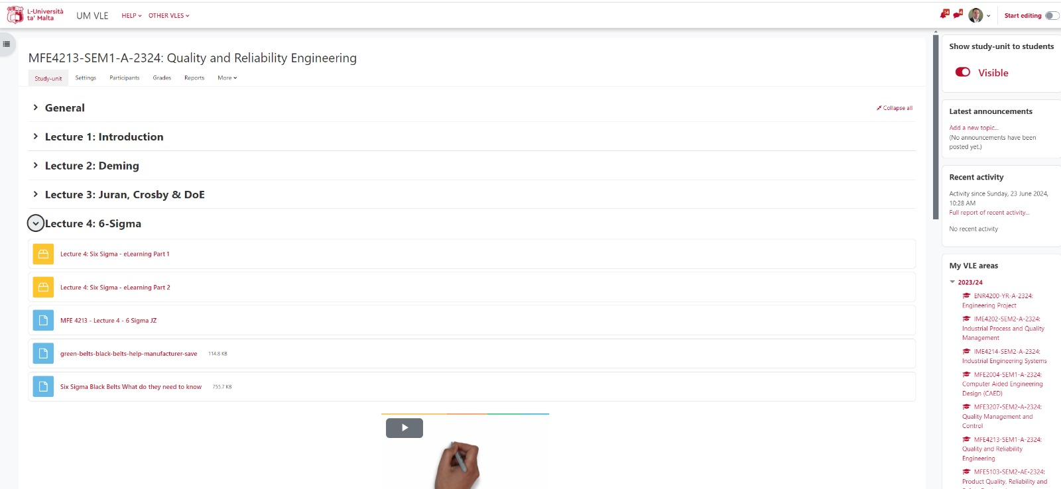
Part 1 - Materials

Slide 11
Part 2
Week 1
Week 2
Week 3
Part 1
Part 2
Part 3
Part 4
ILO reference (Highlight the Verb) | Teaching Activity (What the teachers do) | Learning Activity (What the students do)
ILO 2 Apply the Six-Sigma process improvement methodologies to an engineering case study. (in class) | TA 2.1 Present brief presentation of the key points of the Theoretical and background knowledge of six-sigma process improvement methodologies | LA 2.1 Listen to presentations, take notes and ask questions.

Slide 12
Part 2
Week 1
Week 2
Week 3
Part 1
Part 2
Part 3
Part 4
Supporting Materials:
Presentation
Supporting equipment: None
Supporting facilities: Lecture Room
Instructions:
Lecturer provides a brief summary of Six Sigma principles, emphasizing key points..

Slide 13
Part 2 - Materials

Slide 14
Part 2
Week 1
Week 2
Week 3
Part 1
Part 2
Part 3
Part 4
ILO reference (Highlight the Verb) | Teaching Activity (What the teachers do) | Learning Activity (What the students do)
ILO 2 Apply the Six-Sigma process improvement methodologies to an engineering case study. (in class) | TA 2.2 Make (Introduce) group exercise to apply six-sigma process improvement methodologies to an engineering case study. TA 2.3 Support the students during their work with applying. | LA 2.2 Practice (solve) in groups with the support of tutor to solve case study

Slide 15
Part 3
Week 1
Week 2
Week 3
Part 1
Part 2
Part 3
Part 4
Supporting Materials:
Case Study Templates
Workshop Instructions
Supporting equipment: None
Supporting facilities: Lecture Room
Instructions:
Students will form groups of 4.
Each group will receive a case study to work on.
Duration: 1 hour and 15 minutes.

Slide 16
Workshop Instructions
Read the Provided Case Study:
Thoroughly understand the context and requirements of the case study.
Identify the Appropriate Six Sigma Methodology:
Determine which Six Sigma methodology (DMAIC, DMADV, etc.) is most suitable for the case.
Apply the Selected Methodology:
Follow the steps of the chosen Six Sigma methodology to address the case study.
Develop a Plan:
Create a short presentation summarizing your approach, findings, and proposed solutions.

Slide 17
Part 3 - Materials

Slide 18
Part 4
Week 1
Week 2
Week 3
Part 1
Part 2
Part 3
Part 4
ILO reference (Highlight the Verb) | Teaching Activity (What the teachers do) | Learning Activity (What the students do)
ILO 3 Present and defend the findings which will be discussed in class and criticize the other group’s findings. | TA 3.1 Organize groups to present findings. Question and stimulate reflection to the students. | LA 3.1 Present in groups the finding. LA 3.2 Discuss group finding and class and defend findings. Question and stimulate reflection to their peers.

Slide 19
Part 4
Week 1
Week 2
Week 3
Part 1
Part 2
Part 3
Part 4
Supporting Materials: None
Supporting equipment: None
Supporting facilities: Classroom
Instructions:
Each group will have 5 minutes to present their work.
Presentations should cover the case study analysis, methodology applied, and proposed solutions.
After each presentation, the group will answer questions from the class and the instructor.

Slide 20
Unit Overview
1 ECTS
Lecturer Contact Hours:
4 Hours Total
Part 2 & Part 3: 2 Hours
Part 4: 2 Hours
Student Hours:
20 Hours Total
Part 1 Initial Self Study: 4 Hours
Group work on Case Study: 16 Hours
Total Hours:
24 Hours Total

